Slide 1
CONTENT
INTRODUCTION
CHARACTERISTIC OF C4 PLANT
KRANZ ANATOMY
C4 PATHWAY
SIGNIFICANCE OF C4 CYCLE
DEFFERENCE BETWEEN C3 CYCLE & C4 CYCLE
WHAT IS CAM?
CHARECTERISTIC CAM PLANT
CAM PATHWAY
SIGNIFICANCE OF CAM PATHWAY

Slide 2
INTRODUCTION
Up to 1965, it was believed that the fixation of co2 photosynthesis of higher plants and algae takes place only by bensoncalvin cycle,but kortschak, Hartt and Burr (1965) demonstrated with the use of c12o2 that in sugarcane leaves the chief synthesized labelled product are c4- dicarboxylic acid like malate, aspartate etc.
Their observations were confirmed by M.D.Hatch and C.R Slack (1966).
They told that during photosynthesis in sugarcane leaves 4-carbon substance like oxaloacetate, malate and aspartate are synthesised within a very short time.

Slide 3
Later on, these observations have been confirmed in other monocotyladonous plants like Zea Mays, Sorghum, panicum maximum and Cyperus and some dicotyledonous plants like Amaranthus and Atriplex etc.
Thus, this cycle occurs in the members of cyperaceae and some dicotyledonus plants in addition to members of graminae.
This cycle was named after the discovers as
Hatch- Slack cycle.it is
also
and co-operative
called β-
carboxylation path way photosynthesis.

Slide 4
The first stable compond Hatch-Slack cycle is 4-carbon oxaloacetic acid.
Therefore, it is called c4-cycle.
Such plants wich possess c4 cycle are called c4 plants.

Slide 5
CHARECTERISTIC C4 PLANTS
The leaves of c4 plants possess special anatomy kranz type. The vascular elements in c4 leaves remain surrounded by a layer of bundle sheath cells containing chloroplast in abundance. The bundle sheath is surrunded one to three layers of mesophyll cells which possess very small intercellular space.
The chloroplats in c4 leaves are dimorphic i.e,distinctly of two types (a) the chloroplasts of mesophyll cella are of normal type, (b) the chloroplasts of bundle sheath cells are comparatively quite larger in size, without grana or

Slide 6
- PS -2 but contain starch grains and arranged centripetally.
PEP carboxylase enzyme occurs in mesophyll cells.
C4 cycle is performed in mesophyll cells while c3 cycle is performed in cells of bundle sheath.
They possess two types of co2 acceptor – (a) phosphoenol pyruvate which occurs in the mesophyll cells , (b) Ribulose diphosphate (RuDP) which occurs in the bundle sheath cells.
In them, the first stable compound formed is oxloacetic acid

Slide 7
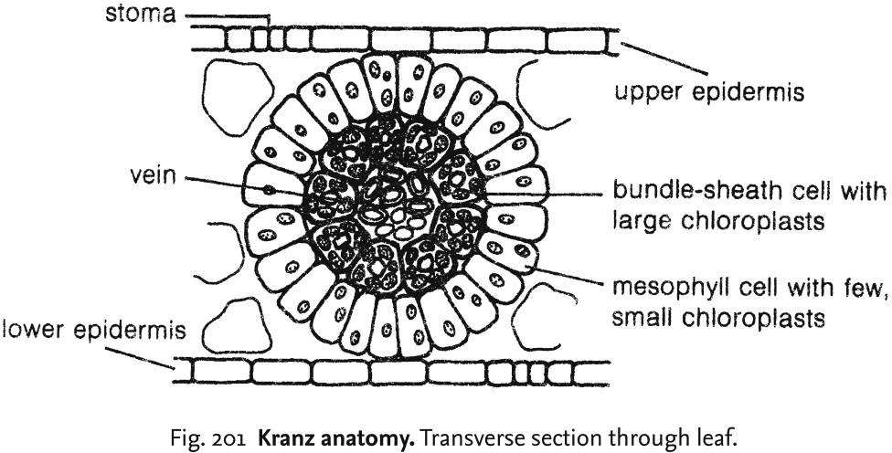
KRANZ ANATOMY

Slide 8
C4 plants are found in tropical and subtropical regions.
They grow fast at high temperature and in more light intensities. Therefore, c4 plants are called efficient plants. The optimum temperature for their growth varies from 30 to 45˚C.
In C4 plants, the O2 has no inhibitory effect.
They lack photo- respiration.

Slide 9
C4 PATHWAY
Reaction of Hatch & Slack cycle:
Hatch & Slack cycle is completed in the chloroplasts of mesophyll cells and bundle sheath cells following reactions occur during this cycle.
Reaction occurring in the chloroplst of mesophyll cell.
  Formation of oxalo-acetic acid:- The primary accepter of co2 in this cycle is a 3C-compund – phosphoenol pyruvic acid. In mesophyll cells, the atmospheric CO2 first combines with water to form bicarbonate ion (HCO3¯) in presence of enzyme carbonic anhydrase.
CO2 + H2O HCO3¯

Slide 10
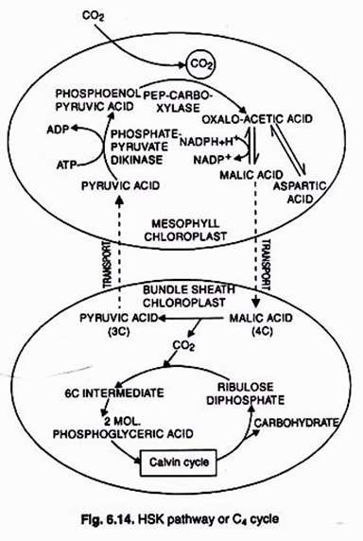

Slide 11
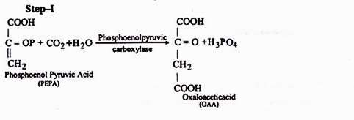
The CO2 accepter, phosphoenol pyruvic acid (PEP), combine with CO2 and forms a 4C acid- oxaloacetic acid in presence of enzyme PEP carboxylase. The enzyme remain present in large amount in mesophyll cells.

Slide 12
2) Formation of malic acid and aspartic acid :-
oxaloacetic acid is quite unstable and is converted either into malic acid or aspartic acid.
The oxaloacetic acid is reduced to malic acid by using light-generated NADPH + H⁺. This reaction is catalysed by enzyme malic dehydrogenase.
The oxaloacetic acid can also be converted into aspartic acid in presence of enzyme aspartic transminase.
The C4 acids i.e , malic acid and aspartic acid are then transported to the chloroplasts of the bundle sheath.

Slide 13
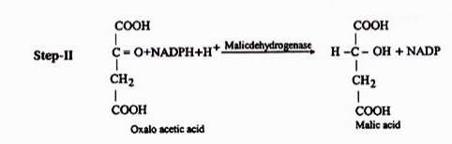
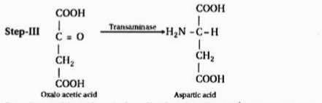

Slide 14
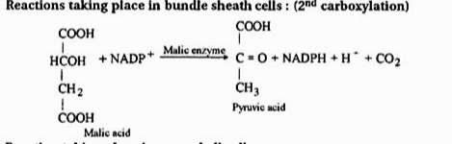
Reaction occurring in bundle sheath chloroplast:-
3) Formation of pyruvic acid-
In bundle sheath chloroplast, the malic acid undergoes oxidative decarboxylation to yield pyruvic acid and CO2 in presence of malic enzyme.

Slide 15
The CO2 and NADP + H⁺ , produced by oxidative decarboxylation of malic enter into calvin cycle. The co2 combines with ribulose diphosphates (RuDP) to yield 2 molecules of phosphoglyceric acid (PGA)
CO2 + RuDP 2 Mols. PGA.
In a few C4 plants the aspartic acid undergoes transmination to form oxaloacetic acid which is then decarboxylated to pyruvic acid. This reaction is catalysed by aspartate transminase.
L-Aspartic acid oxaloacetic acid pyruvic acid

Slide 16
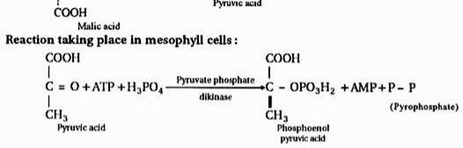
6) Formation of phosphoenol pyruvic acid (PEP):-
- the pyruvic acid produced
is transported
by oxidative back to the
to
decarboxylation
mesophyll cells
where is it phosphorylated
phosphoenol pyruvic acid in presence of enzyme pyruvate phosphate dikinase. This enzyme is unusual because it splits one molecule of ATP, (synthesized in photosynthetic light reaction), into AMP and Ppi.

Slide 17
SIGNIFICATION OF C4 CYCLE
In C4 plants , it increase the photosynthetic yield two to three times more than c3 plants.
In C4 plants , it performs a high rate of photosynthesis even when the stomata are nearly closed.
It increase the adaptability of C4 plants to high temprature and light intensities.
They can very well grow in saline soils because of presence of C4 organic acid.

Slide 18
DEFFERENCE BETWEEN C3 & C4 CYCLE
C3 Cycle :
The primary CO2 accepter is a 5c compund Ribulose diphosphate (RuDP).
The first stable compund phosphoglyceric acid (PGA) which atoms.
formed is contain 3 C
C3 cycle is completed in only one type of chloroplast present in mesophyll.
It takes place at comparatively low temperature.
Photorespiration occurs in C3 plants.
The rate of photosynthesis is comparatively lower.
It occurs in C3 plants which show normal anatomy.

Slide 19
C4 cycle
The primary CO2 accepter is a 3 C compund – phosphoenol pyruvic acid (PEP).
The first stable compound is a 4C oxaloacetic acid.
C4 cycle is copmleted in two types of chloroplasts, one occuring in mesophyll cells and other in bundle sheath cells.
It takes place at high temperature and more light intensities.
Photorespiration does not occur in C4 plants.
The rate of photosynthesis is comparatively higher.
It occurs in C4 plant which show kranz anatomy.

Slide 20
INTRODUCTION of CAM
Occurres Mostly in succulent plants which grow under semi-arid conditions. Since the cycle was first discovered in the plants belonging to family crassulaceae e.g , Bryophyllum, Sedium calycinum etc., it was named as crassulacean Acid , orchid and pine apple families.
CAM cycle is competed in two parts (A) Acidification (B) Deacidification.
Acidification takes place in dark while deacidification occurs during day time.

Slide 21
CHARACTERISTIC CAM PLANTS
They fix atmospheric CO2 in dark and accumulate large amount of malic acid.
They show diurnal pattern of organic acid formation i.e, they accumulate organic acids in the leaves at night and decrease during the day. In such plants, the pH of cell sap substanially they with the accumulation of organic acids.
They are usually succulents. In CAM plants , the vacuoles normallyfunction as a accumulation of organic acis (malic acid).

Slide 22
They possess xerophytic characters like thick cuticle, sunken stomata , thorns and reduced leaves.
They stomata remain closed during the day (light) and open at night (dark).
They show maximum gaseous exchange at night because of nocturnal opening of stomata.
They show decrease in starch content during night and increase during the day.
They possess high level of phosphoenol pyruvate and an active decarbolase.

Slide 23
CAM cycle is competed in two parts (A) Acidification (B) Deacidification.
A) Acidification:-
- various step during acidification are as follows:-
The stored carbohydrates are converted into phosphoenol pyruvic acid (PEP) through glycolysis. The CO2 diffuses freely into the leaf through open stomata in night.
The PEP is carboxylated into oxaloacetic acid (OAA) in presence of enzyme PEP carboxylase.
PEP + CO2 + H2O OAA + H3PO4

Slide 24
III) The oxaloacetic acid is now reduced to malic acid in presence of enzyme malic dehydrogenase. This reaction is facilitated in presence of reduced NADP+ (NADP + H⁺) formed during glycolysis.
OAA + NADP + H⁺ Malic acid + NADP⁺
- The malic acid , thus, produced in dark as a result of acidification is stored in the vacuole. The oxaloacetic acid may also be interconverted into aspartic acid.

Slide 25
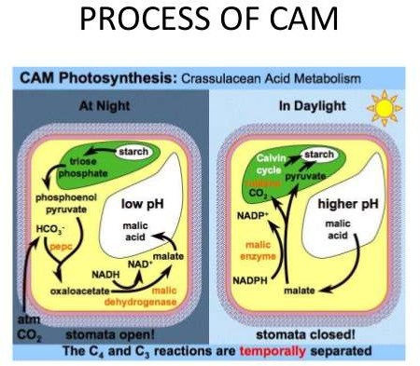

Slide 26
B) Diacidification:-
The dicarboxylation of malic acid into pyruvic acid and CO2 in presence of light is called deacidification. In light, during deacidification the malic acid formed during night cnverted into pyruvic acid and CO2 in presence of malic enzyme. In certain plants , this reaction is catalased by PEP carboxylase. One molecule of NADP+ is also reduced in this reaction.
Malic acid +NADP⁺
Pyruvicacid + NADPH+ H⁺+ CO2

Slide 27
The pyruvic acid formed in this reaction is either oxidized to CO2 through kreb’s cycle or reconverted to PEP or phosphoglyceric acid to synthesis sugar through C3 cycle.
The CO2 liberated by deacidification of malic acid is accepted by ribulose diphosphate (RuDP) to fix it into carbohydrate through C3 cycle (calvin cycle). However, the fate of pyruvic acid is still not clearly known.

Slide 28
SIGNIFICANCE of CAM
As CAM plants are able to fix CO2 in dark, they can survive for longer periods in light withous CO2 uptake.
The stomata of leaves remain closed during the day and open at night.this is an adaptation to conserve water , since succulents exhibiting CAM are found in dry habitat.
During the night CO2 is taken into the leaves through open stomata. This limits the photosynthesis. It is also limited by stored organic acid and carbohydrates causing slow growth of the plants. Thus CAM plants are generally slow growing
They are drought resistant and possess xerophytic adaptations like thick fleshy leaves .

Slide 29
REFERENCES
V. V. VEMA PLANT PHYSIOLOGY
PLANT PHYSIOLOGY BY TAIZ & ZEIGER
WWW. WIKIPIPEDIA. COM

Slide 30
THANK
YOU

